Slide 1







GENERATING NARRATIVE
FINAL PRESENTATION
Presented by : Supriyo Pal, Trina Chowdhury, Hadiya Mushtaq, Ishita Das, Bharadwaj V, Sanjay Babu C. S
Project Mentor(s)
Ishpreet Kaur, Kuljeet Singh
& Sundeep Narwani
20.12.2024

Slide 2

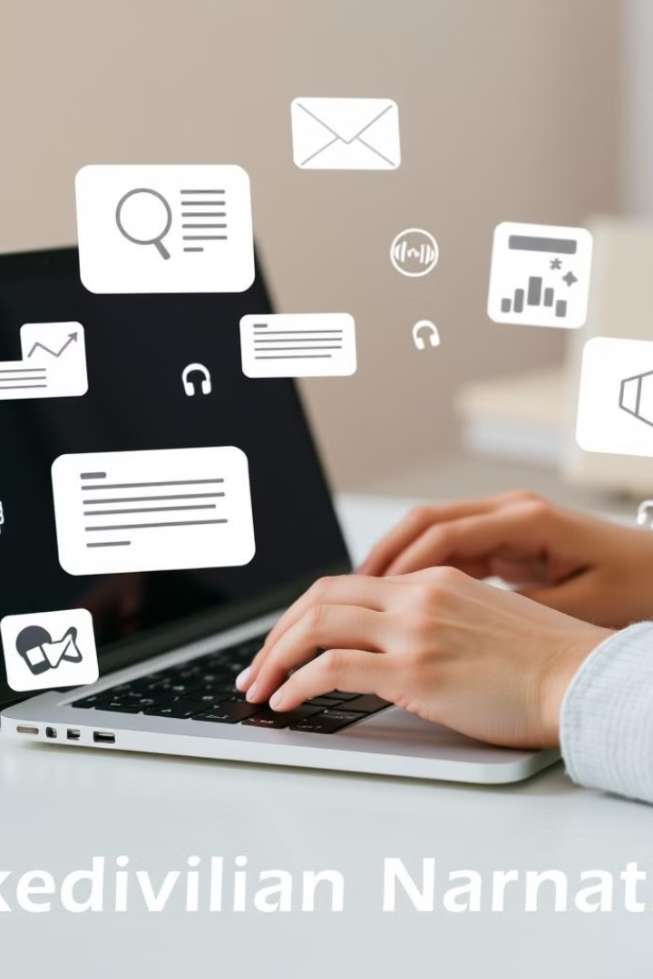
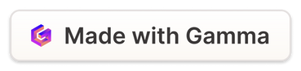
Problem Statement
This project aims to streamline the creation of multimedia narratives by automating the process of generating stories, images, voiceovers, and videos from simple text prompts. It addresses the challenge of separately handling text, visuals, and audio for content creation. By integrating these elements into a seamless workflow, users can easily generate engaging, high-quality video narratives. This approach to storytelling is highly effective and particularly appealing to younger audiences, especially YouTubers, making it an ideal tool for captivating and interactive content creation.
Notes:
1

Slide 3
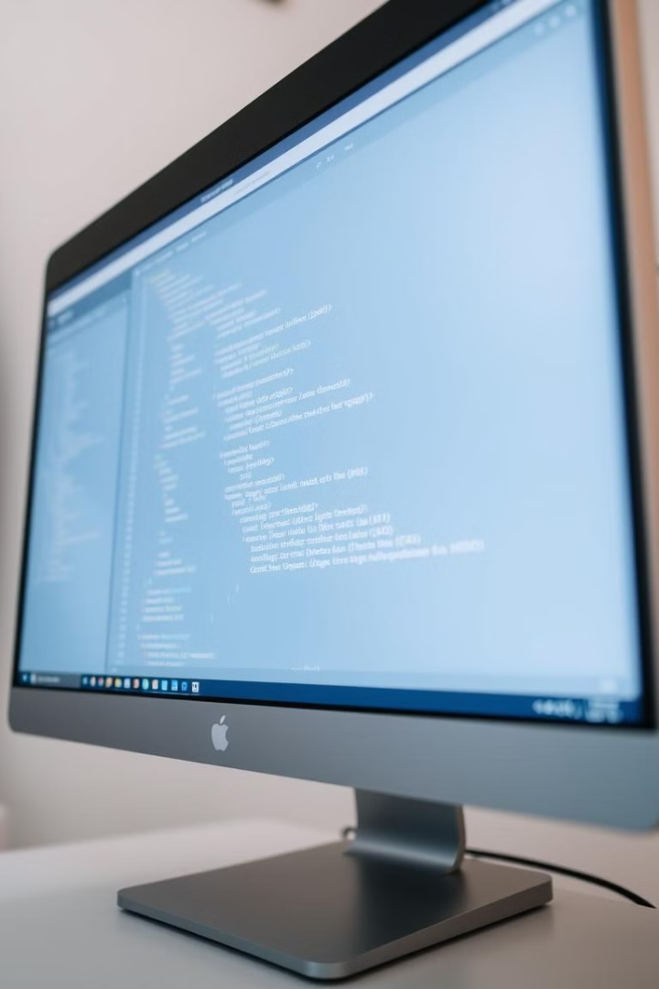
Project Overview
Text Generation
An advanced text generation system produces high-quality, coherent, and contextually rich stories.
Image Generation
Visually compelling and contextually accurate images are created using prompts from the generated text.
Speech Generation
The final text outputs are converted into natural-sounding speech, making the content more accessible and immersive.
Notes:
2

Slide 4
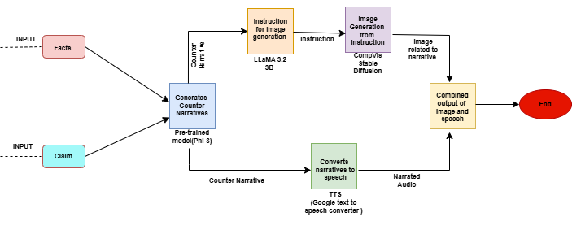
PROJECT FLOW

Slide 5
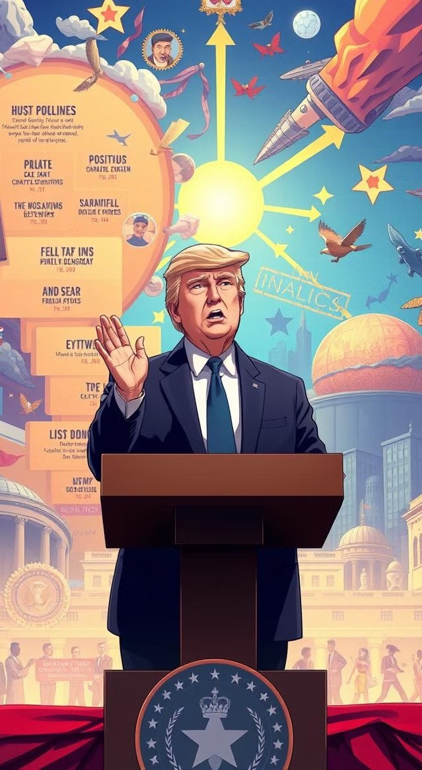
Dataset Collection &
Preprocessing
1
Source
The data for this analysis comes from a US election news article containing claims made by Donald Trump. The claims were sourced from a CNN article titled "Fact-check: Trump and Musk make 20 false claims in one day."
2
Data Analysis
he analysis revealed five consistent patterns in Trump's claims: exaggeration of figures, misrepresentation of facts, misleading attribution of actions or roles, assertions without evidence, and undermining established facts or processes.
3
Image Prompt Refinement
LLaMA-3.2-3B-Instruct is used to refine counter-narratives into concise and structured prompts for Stable Diffusion.
Notes:
8

Slide 6
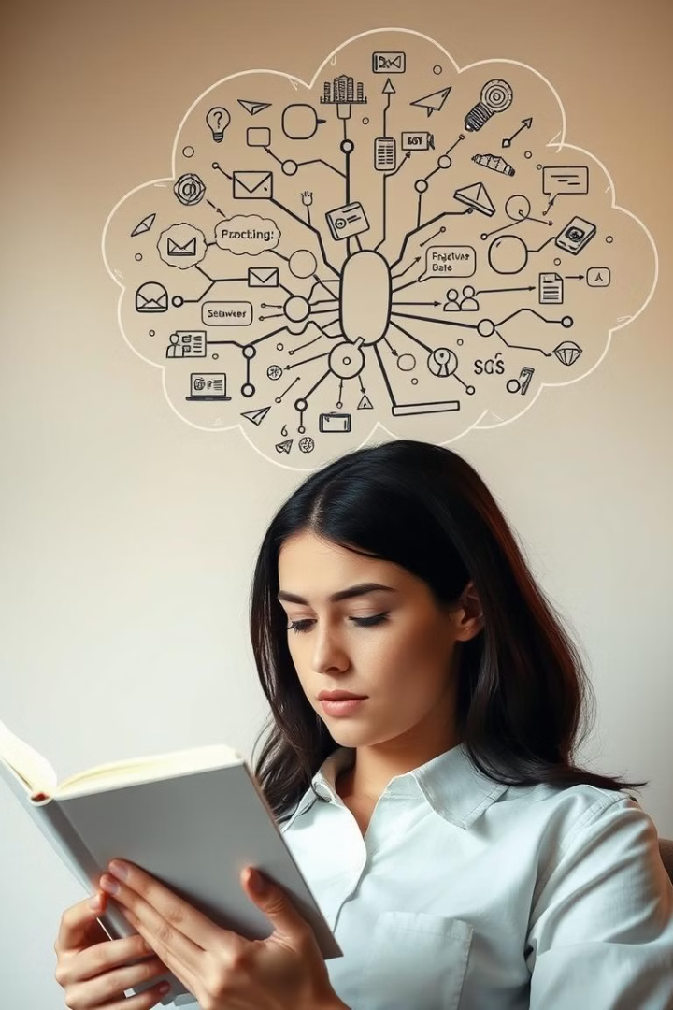
Counter-Narrative Generation
1
Model
2
Input
Phi-3-mini-128k-instruct
Fact-claim pairs
3
Output
Long and summarized counter-narratives, integrating verified facts, dates, and statistics with vivid descriptions ,coherence, accuracy, and tone
4
Output Type
Long Counter-Narratives: 200–400 words.
Summarized Counter-Narratives: ≤ 250 words.
Notes:
3

Slide 7
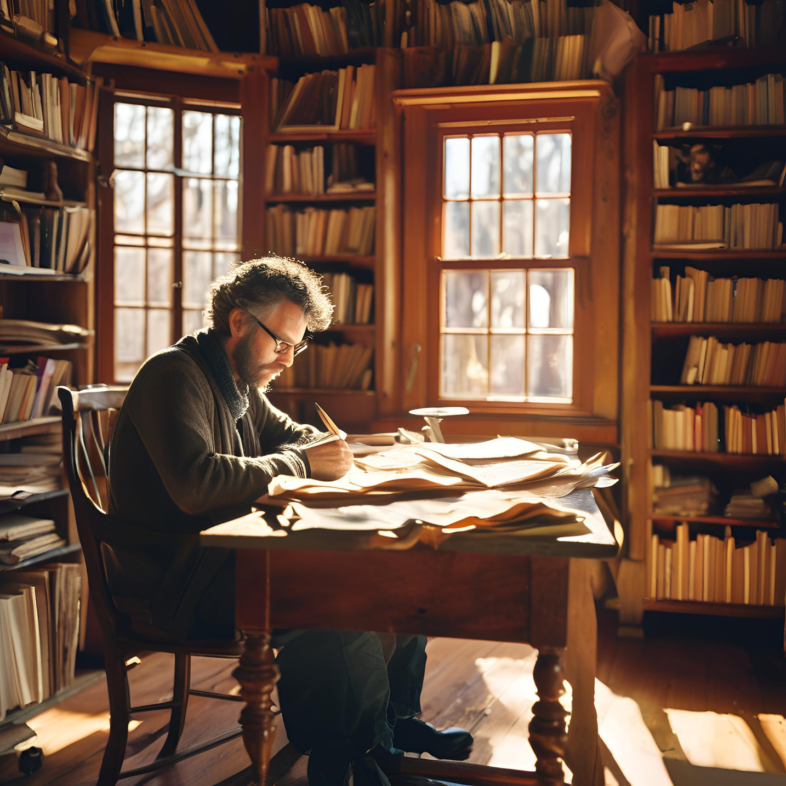
Narrative Generation:
Phi-3 Model Performance
Narrative Quality
Summarized counter-narratives (≤250 words) were more coherent and concise. Longer narratives (200–400 words) were tested but not as effective for downstream tasks.
Key Characteristics
The generated narratives strictly adhere to verified historical facts, rephrasing provided inputs, strengthening the counter-argument. Original facts are included beyond references to important dates, statistics, and data are prominently integrated.
Notes:
2

Slide 8
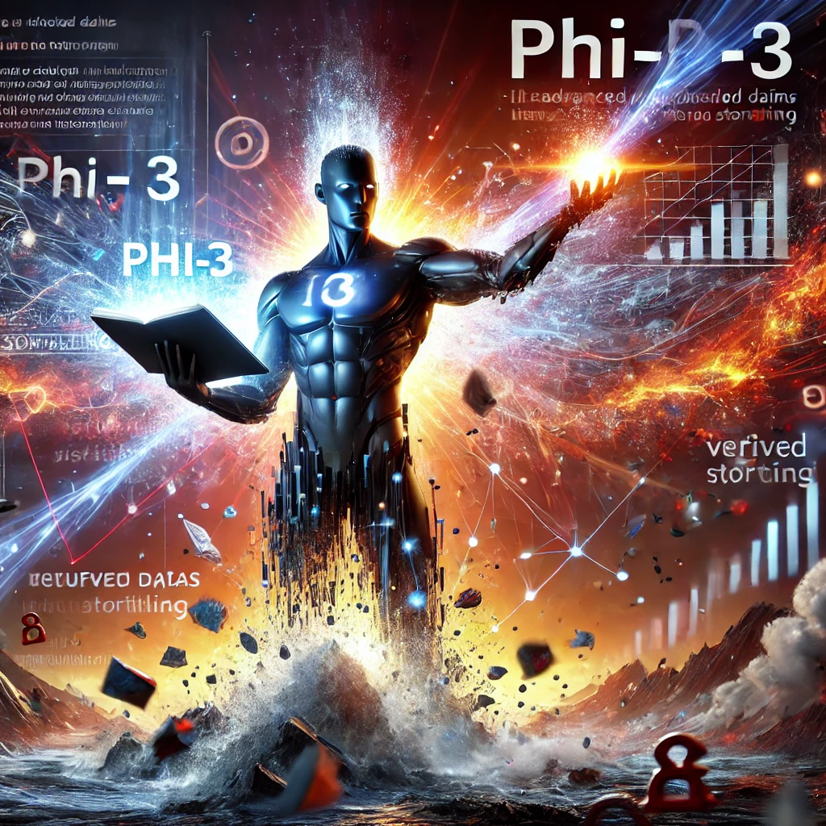
Comparative Analysis for Phi-3
Outcome and Impact for Phi-3:
High Factual Accuracy: Phi-3 effectively refutes claims with verified data, ensuring credibility and precision.
Vivid Storytelling: Combines strong imagery and human experiences to create engaging, emotionally resonant narratives.
Aggressive yet Coherent Tone: Maintains assertiveness while ensuring logical flow and clarity in counter-narratives.
Adaptable Outputs: Generates both detailed and concise narratives suitable for various platforms and audiences.
Superior to Llama 3.2: Outperforms in vivid imagery, assertive specificity, and emotional engagement, while Llama 3.2 excels in contextual understanding.
Impactful Narrative Design: Blends accuracy and creativity, delivering outputs that are both compelling and fact-driven.
Notes:
4

Slide 9
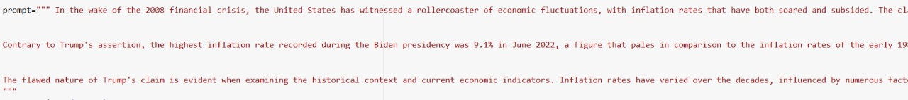
Why we need Intermediate Model??
Initially, we attempted to directly feed counter-narratives into the image generation model (e.g., Stable Diffusion). However, this approach often resulted in outputs that were vague, irrelevant, or inconsistent.
Also stable diffusion could only handle input sequence upto 77 tokens
Notes:
1

Slide 10

Intermediate Prompt Refinement:
1
Model
LLaMA-3.2-3B-Instruct
2
Input
Counter-narrative from Phi-3-mini-128k-instruct.
3
Output
Narratives summarized and transformed into descriptive yet focused prompts with a token limit, ensuring that only the most relevant details were included.
Notes:
5

Slide 11



Intermediate Model Performance
Exploring Prompt Formats
Summarized Counter-Narratives
Narrative Titles
Summaries and Titles Combined
The instructions were well-aligned with the narrative theme as the title provided a concise overview, and the summary added detailed context. This combination helped create instructions capturing both essence and depth. However, occasional redundancy from overlapping information slightly impacted coherence.
Visuals generated are closely aligned with the counter-narrative theme and provide strong metaphorical representations.
Results were less detailed due to limited context provided by titles alone.
Notes:
6

Slide 12
Comparative Analysis Intermediate Model
Summarized Counter-Narratives
Narrative Titles
Summaries and Titles Combined
Using summarized counter-narratives yielded visuals strongly aligned with the theme, offering rich metaphorical representations.
In contrast, narrative titles alone resulted in less detailed outputs due to limited context.
Combining summaries and titles struck a balance, providing both depth and clarity, though occasional redundancy slightly affected coherence.
Example:”A tug-of-war rope with a frayed end, representing the false claim, is pulled by a figure in a suit, symbolizing Trump, while a figure in a suit with a rope of smooth, unbroken thread, representing accurate data, pulls in the opposite direction, signifying the truth and the decline in inflation."
Example:img = "Rising Tides of Deception: A Climate Crisis Unveiled"
prompt = f"""
Generate a symbolic tug-of-war scene representing the struggle between fact and claim.
The image should correspond to the title: "{img}".
Example:Generate an image representing economic fluctuation, specifically depicting a graph with a peak at 9.1% and a current rate of 3.2%, with a red line indicating the peak during the Biden presidency and a blue line showing the current rate. Include a subtle background image of a US stock market ticker or a graph of historical inflation rates to emphasize the context.
Notes:
4

Slide 13
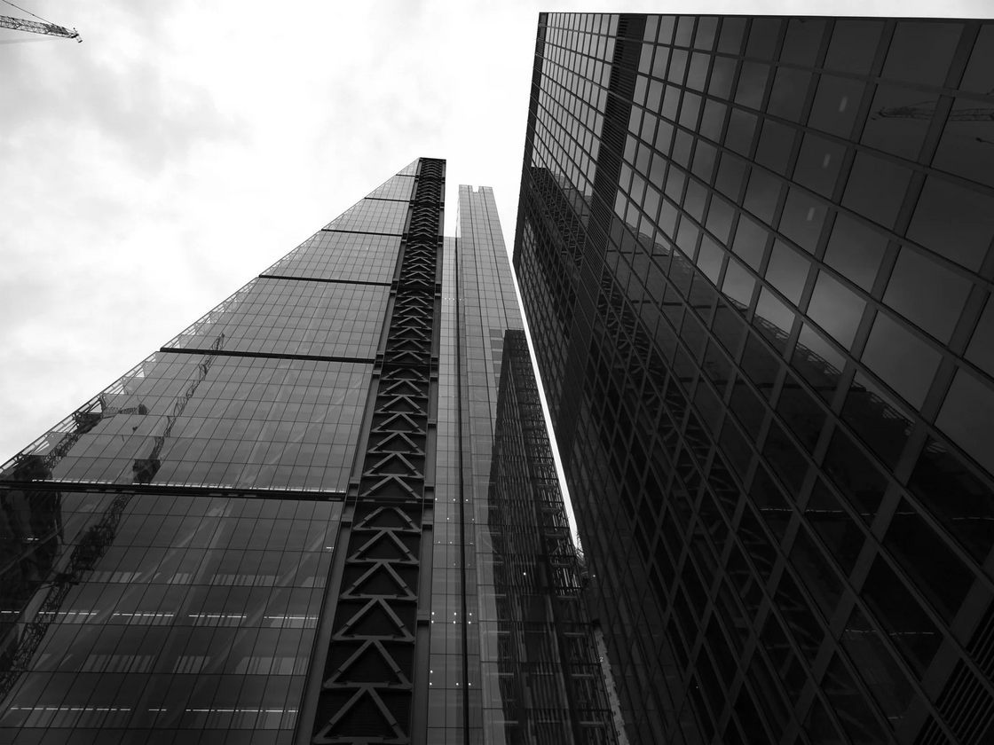
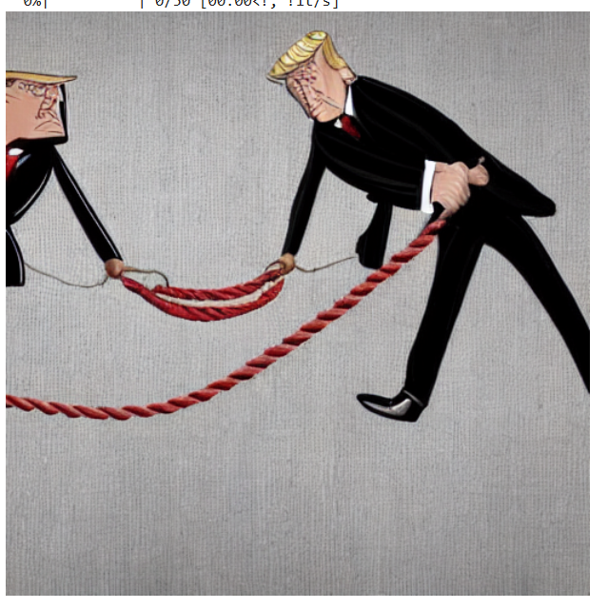
Image Synthesis
Model
CompVis Stable Diffusion v1-4.
Structured image instructions generated from LLaMA-3.2-3B-Instruct.
Input
Output Sample
Visually rich, thematically accurate, and contextually aligned images.
Output

Slide 14
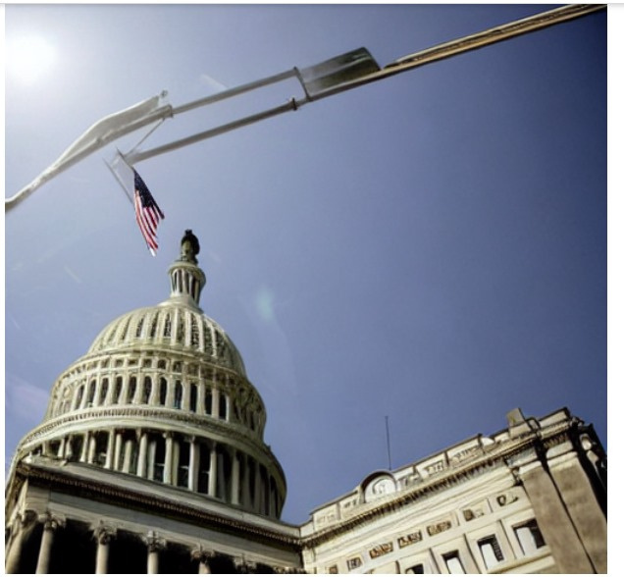
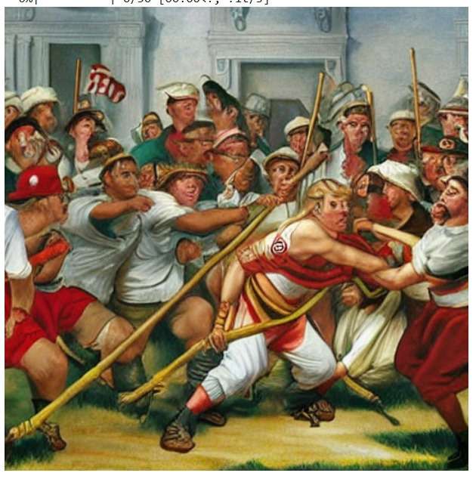
DIFFERENT APPROACHES ANALYSIS:
1
3
From Narrative Titles
Lack of depth and metaphorical richness.
From counter-narrative itself
Token issue- clipped part

Slide 15
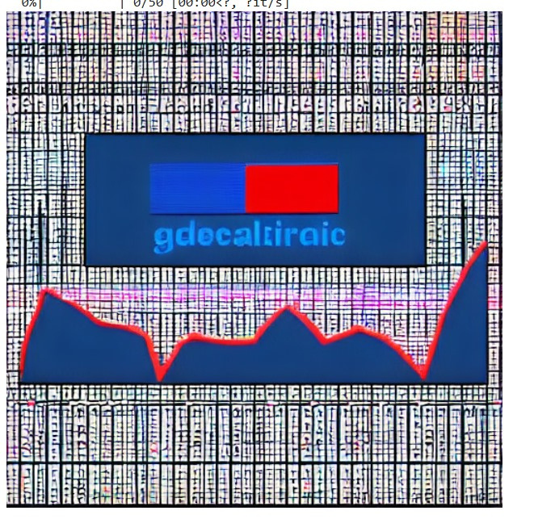
DIFFERENT APPROACHES ANALYSIS:
1
3
Instructions from Summarized Counter-Narratives
Strong alignment
From Summaries and Titles Combined
Appeared cluttered or lacked focus

Slide 16




Comparing:
Image Generation Models
CompVis/stable-diffusion-v1-4
runwayml/stable-diffusion-v1-5
Notes:
9

Slide 17



Comparing:
Image Generation Models
CompVis/stable-diffusion-v1-4
runwayml/stable-diffusion-v1-5
Better narrative allignment
Moderate image quality
Weaker narrative allignment
Higher image quality
Both models face the 77-token limit issue, but we chose CompVis Stable Diffusion V1-4 as it prioritizes narrative coherence over image quality.
Notes:
9

Slide 18
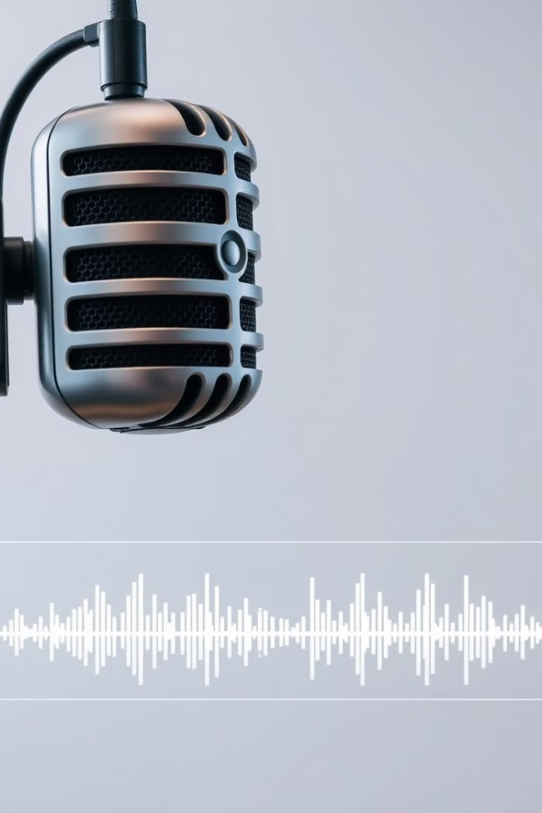
Text-to-Speech Conversion
1
Model
2
Input
Google Text-to-Speech (gTTS)
Counter-narrative from Phi-3-mini-128k-instruct.
3
Output
Audio form of the counter-narrative.
Notes:
6

Slide 19
Comparative Analysis Text to speech model
Outcome and Impact
gTTS
The TTS conversion process successfully added an auditory layer to the multimedia content, enhancing its accessibility and appeal. By leveraging the capabilities of gTTS and optimizing input preparation, the project demonstrated the effectiveness of automated speech generation in creating dynamic and engaging storytelling experiences. This feature significantly broadened the project's usability, making it suitable for podcasts, videos, and other auditory-driven platforms.
gTTS was evaluated alongside other text-to-speech (TTS) systems, such as Coqui AI, based on voice quality, ease of implementation, and cost-effectiveness. While gTTS performed well for this project, some alternative model exhibited a tendency to skip words during speech conversion, making gTTS a more reliable choice.
Notes:
4

Slide 20
TTS: Adding an Auditory Dimension
1
Challenges
2
Model Selection
3
Process of TTS Conversion
While exploring alternative text-to-speech (TTS) models, there encountered a significant challenge where some models exhibited a tendency to skip words during speech conversion. This inconsistency affected the overall reliability of the speech output.
Google Text-to-Speech (gTTS) was chosen for its ease of use, reliability, and ability to produce high-quality audio. The model's versatility in handling various languages and accents made it suitable for the project's diverse counter-narratives.
Speech Generation: The Counter-Narrative was fed into gTTS, which converted it into audio with natural pronunciation and appropriate pacing. Output Format: The generated audio was saved in standard formats (e.g., MP3) to ensure compatibility with multimedia integration.
Notes:
8

Slide 21



Challenges
For Generating Narratives
Prompt Refinement: Iterative rephrasing was required to ensure the narratives maintained a consistent tone, logical flow.
Balancing Creativity and Precision: Achieving vivid storytelling with accurate details like dates and figures involved fine-tuning model parameters and input instructions.
1
For Image Generation
We tried initially, feeding counter-narratives directly into the image generation model (Stable Diffusion) but it presented us with several challenges. The outputs were often vague, irrelevant, or misaligned with the intended narrative. Additionally, Stable Diffusion's 77-token limit for prompts clashed with the length of our counter-narratives, which frequently exceeded this limit, further complicating the process.
2
For Text to Speech
3
During the evaluation of text-to-speech (TTS) models, it was observed that some alternative models had a tendency to skip words during speech conversion. This issue led to incomplete or inaccurate speech outputs, which could have negatively impacted the user experience.
Notes:
5

Slide 22
Solutions
For Generating Narratives
1
Fine tuned the prompting style which was inspired by the prompt provided in the hugging face guidelines of google phi-3 instruct document . Added a specific command for tone consistency and coherent narrative generations.
For Image Generation
2
An Intermediate Model was introduced as an intermediary step to bridge this gap. By restructuring counter-narratives into concise, symbolic, and directive prompts, the project aimed to improve the alignment between the input text and the generated images.
For Text to Speech
Implemented gTTS as the chosen TTS model. gTTS provided consistent and accurate speech conversion, proving to be a reliable solution and ensuring the quality and dependability of the project's speech output
3
Notes:
5

Slide 23
Conclusion
This project presents a novel approach to automated multimedia storytelling, combining text generation, image synthesis, and speech conversion into a unified workflow. The project has the potential to revolutionize content creation by making it more accessible, efficient, and engaging for a wide range of users.
Notes:
9

Slide 24
Future Prospects
Narrative Generation
1
Future work can work with models like Gemini, and premium paid options to enhance narrative quality and complexity.
Image Generation
2
Utilizing models with a higher token limit can improve the precision and detail in image generation, enabling more accurate representations.
Text-to-Speech Generation
3
Future work can focus on enhancing voice output by incorporating models with better voice modulation capabilities, reducing the mechanical tone.
Front-End Generation
4
Implementing a front-end generator that presents outputs in a third-person view can enhance user engagement and provide a more immersive experience.
Notes:
10

Slide 25

THANK YOU!!!!

